Slide 1


PUBLIC SOCIOLOGY AND INTERNATIONAL AFFAIRS:
Opportunities and Challenges for African Americans
by Beverly Lindsay*
University of California at Riverside
2023 Annual Conference of the Association of Black Sociologists
Theme: Black Sociology Against the Assault on Racial Knowledge
August 2023
Philadelphia, Pennsylvania
*The Ford Foundation, Fulbright Program. and National Science Foundation funded fellowships and grants for the author’s background material and research for this PowerPoint piece. This presentation represents the perspectives and views of the author, not those of funding agencies. Appropriate educational and research protocols were followed.

Slide 2

PUBLIC SOCIOLOGY AND INTERNATIONAL AFFAIRS
“We can never have too much preparation and training. We must adhere staunchly to the basic principle that anything less than full equality is not enough.
If we compromise on that principle our soul is dead.”
(Ralph Bunche, ND) “
In April 2023, the Fulbright Association convened its annual Awards Ceremony to present the Fulbright Prize, the most distinguished honor for those who made exemplary domestic and global contributions toward addressing challenges facing individuals and nations. Previous awardees include Nelson Mandela and Desmond Tutu. With introductory video remarks by former President Barack Obama, the 2023 recipients are:
Dr. Kizzmekia Corbett and Dr. Anthony Fauci. Both led a National Institute of Health (NIH) team who conducted research leading to the development of a Covid-19 vaccine that saved the lives of billions of global citizens. Indeed, the Covid-19 vaccine and medications for HIV/AIDs – disproportionally affecting Black public and private health – are profound illustrations of public sociology and international affairs.

Slide 3
This Presentation Explores Critical Questions Inter Alia:
1) What fundamental constructs of Public Sociology and International Affairs and diplomacy may lead to mitigating adverse sociocultural and health conditions – disproportionally affecting Blacks;
2) How might Blacks be positioned for research roles in helping diminish detrimental effects upon Blacks, whereby “Dr. Corbetts” become norms;
3) How might Black sociologists foster the integration of public engagement with academic and non-academic audiences;
4) How might Black students and emerging professionals secure Rhodes, Marshall, and Fulbright awards and position themselves for policy research linking domestic and international affairs;
5) How might sociologists engage in collaborations with organizations to alleviate fears of recurrent perceived ill-effects from pandemic vaccines, or continued negative aspects of the “Tuskegee Experiment or Henrietta Lacks”?

Slide 4
Constructs of Public Sociology and International Affairs and Diplomacy
Public Sociology
Sociology to Public Sociology to Public Policy (Burawoy, 2021)
Four types of knowledge: professional, critical, policy, and public
Sociological imagination – personal troubles into public issues (Mills, 1959)
Blending individual or specific organizational needs/views with larger public society (Tamdgidi, 2020; 2008);
Public translation of research to the “public (Korgen and White, 2023)
International Affairs and Diplomacy
Fostering relations with other nations, geopolitical blocs, and geographical regions
Types of international affairs – economic, political, sociocultural, military,
Types of multi-track diplomacy – cultural, economic, faith, sports, philanthropic, and educational entities via collaborative endeavors
Prominent illustration in universities – Rhodes (Oxford); Marshall (United Kingdom); Fulbright (global); Boren (critical languages and regions)
Virtual intellectual migration (Lindsay, 2023; Lindsay, 2022)

Slide 5
Black Positions and Integral Roles in Domestic and International Venues
The Academy
C.L. R. James (Federal City College/University of District of Columbia; study and
work in England and various parts of the USA)
Charles Johnson (First Black President of Fisk University; work in Liberia)
Corporate and Profit Organizations
Philanthropic organizations
Ford Foundation
Rockefeller Foundation
Bloomberg Foundation
Diplomacy
Ambassador (Ret) and Professor Emeritus Horace G. Dawson, Jr (U.S. Department of State and Howard University) (Lindsay, 2021)
Vivian Lowery Derryck (Former Deputy Assistant Secretary of State and Adjunct Faculty at George Washington University)

Slide 6
Black Positions and Integral Roles in Domestic and International Venues
Ralph Bunche First Negro/Coloured Nobel Peace Laureate, Undersecretary of the United Nations, (Lindsay, 2008)
First African American Professor of Government/Political
Science at Harvard University – did not formally relocate to
Harvard;
Advisor to eminent attorney Thurgood Marshall and historian
John Hope Franklin on Brown v Board of Education;
Research and Publication from/on The American Dilemma and
Coloured in American South and Dahomey – now Benin/Togo
Anthropological and Sociological research methods from BA to
Ph.D. to United Nations
Advisor to Dr. Martin Luther King, Jr. and Civil Rights
organizations

Slide 7
Black Positions and Integral Roles in Domestic and International Venues
Students and Professionals in Domestic and International Venues
Rhodes Scholars -- (32 Americans are selected)
6 Black American selected in 2022 (Ruf, 2021)
953 Applicants (Nietzel, 2021)
Study for master’s at the University of Oxford college
Phaidra Buchanan (B.S.Ed. ’21) – University of Georgia First African American Rhodes
Scholar (Mary Frances Early College of Education – in 2021 only major research
university College of Education named for a Black/Colored educator)
BS Ed in Education – foci on social studies
Studied computing ethics at the University of Oxford in England as a Foundation
Fellow
Studied German and sustainability practices at Goethe-Institut in Freiburg,
Germany
Participated in the College’s Ghana Study Abroad in Education program,
examining school models in Accra, Kumasi, and Cape Coast

Slide 8
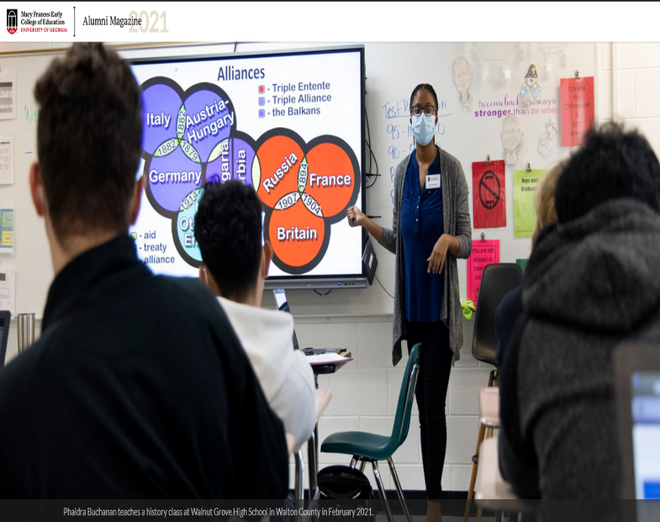
Black Positions and Integral Roles in Domestic and International Venues
Students and Professionals in Domestic and International Venues (cont.)
Oxford University Rhodes’ Scholar Phaidra Buchanan
Notice the countries/nations and geopolitical issues and regions as Phaidra Buchanan presents to high school students

Slide 9
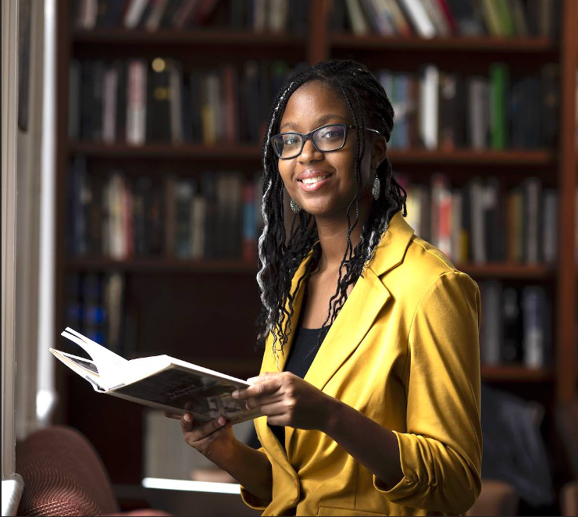
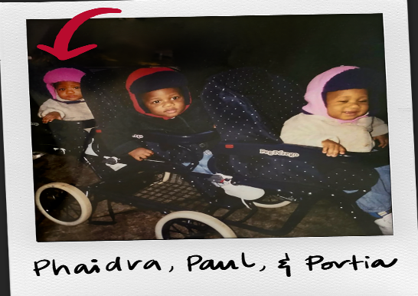
Black Positions and Integral Roles in Domestic and International Venues
Phaidra is the youngest of the triplets.

Slide 10
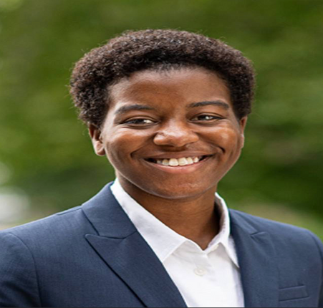
Black Positions and Integral Roles in Domestic and International Venues
Students and Professionals in Domestic and International Venues (cont.)
Marshall Scholars (usually awards 40 Americans each year)
* Began in 1953, named for former Secretary of State George Marshall
and Nobel Peace Laureate (Marshall Scholarships & Mukharji 2023)
* Scholarship to study in the United Kingdom, a close ally of the United States
Beverly Lindsay (Principal Investigator of National Science Foundation [NSF]
grant and Eric Simeon Ph.D. Doctoral Research Assistant)
* Interviews with women and men American Marshall Scholars studying for master’s
degrees in a range of fields – one African American man withdrew from Rhodes
competition and pursued the Marshall since Oxford University did not have the
strongest United Kingdom Ph.D. programs in Astrophysics – Eventual goal to earn
Ph.D. from Harvard University
Julia Chaffers, Princeton University BA in History (Arnson, 2021)
2022 Marshall Scholarship – Study one year at University College
London in United States History and Politics; Second year at University
of Manchester to study British history and politics for global context
interest in public history

Slide 11
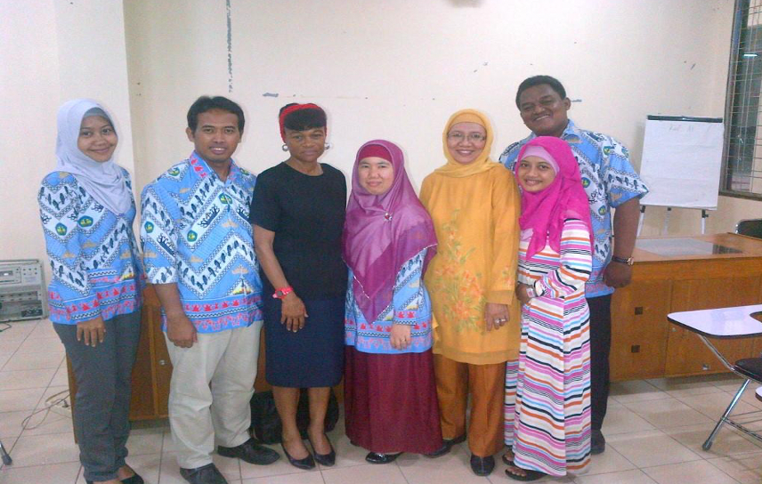
Black Positions and Integral Roles in Domestic and International Venues
Students and Professionals in Domestic and International Venues (cont.)
Fulbright Fellowships
Established in 1946 from World War II surplus funds lead by
Senator J. William Fulbright (Bureau of. Educational and
Cultural Affairs, 2023) Lindsay, 2022; Lindsay 2021)
Over 4000,000 alumni, involving 160 countries on six
continents
6% of American applicants are Black (Bureau of Educational
and Cultural Affairs, 2022-November
1). Academic Peace Corps, stated by a former Executive
Vice President and Provost at Penn State
University – regarding Fulbrights to Africa and
developing countries (Lindsay, 2022)
Beverly Lindsay -- Fulbright at University of Lampung in Lampung Province in Indonesia, on Sumatra Island. Dr. Lindsay team-taught research methods and presentations to the medical faculty at the University. (Fall 2013)

Slide 12
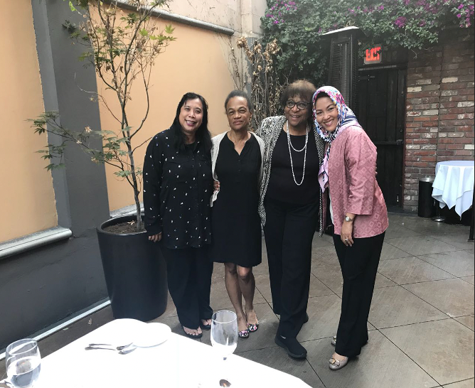
Sociologists and Collaborations with Organizations to Alleviate
Conflicts and Fears via Public Sociology
Ford Foundation Grant for Women’s Leadership Institute—Division of Social Sciences – University of California-Riverside included Indonesian and Myanmar women presidents/rectors, deans from Lindsay Fulbrights in Indonesia and Myanmar University Deans from Indonesia and Drs. Lindsay and Moses
Result: Establishment of food banks via models at Cal State, San Bernardino

Slide 13
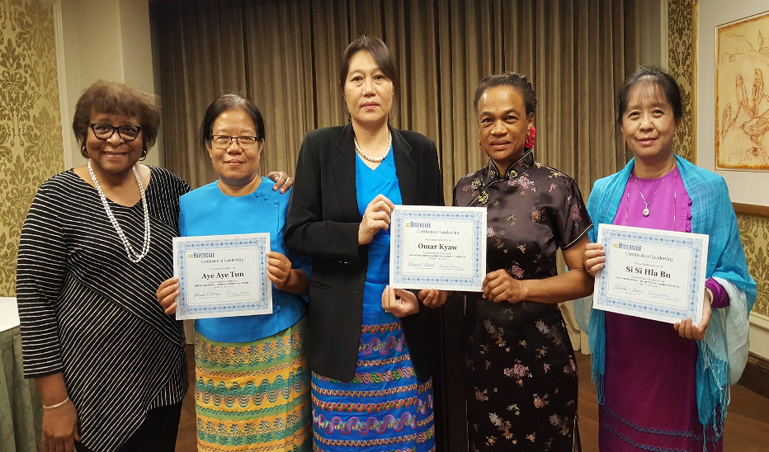
Sociologists and Collaborations with Organizations to Alleviate
Conflicts and Fears via Public Sociology (cont.)
Drs. Lindsay and Moses with Myanmar University Rectors/Presidents as they receive their University of California-Riverside University Women’s Leadership Certificate. The photo and following caption appeared on the American Embassy, Yangon Facebook.
Result: Establishment of food banks (during Covid-19) via models at Cal State, San Bernardino and counseling services during Myanmar coup d’état

Slide 14
Sociologists and Collaborations with Organizations to Alleviate
Conflicts and Fears via Public Sociology
ဖုိ႔ဒ္ေဖာင္ေဒးရွင္းရဲ႕ကူညီပံ့ပုိးမႈနဲ႔ အေမရိကန္ျပည္ေထာင္စုမွာ ဒီလအတြင္း Institute on Women and Leadership in Post-Conflict and Transitional Societies အစီအစဥ္ကုိတက္ေရာက္ခဲ့ၾကသူ ျမန္မာႏုိင္ငံ တကၠသုိလ္ေတြက အမ်ဳိးသမီးေခါင္းေဆာင္ သုံးဦးအတြက္ ဂုဏ္ယူပါတယ္။ ရန္ကုန္တကၠသုိလ္က ေဒါက္တာဥမၼာေက်ာ္၊ ပုသိမ္တကၠသုိလ္က ေဒါက္တာ စီစီလွဘူးနဲ႔ ပဲခူးတကၠသုိလ္က ေဒါက္တာ ေအးေအးထြန္းတုိ႔ဟာ သူတုိ႔ရဲ႕ေခါင္းေဆာင္မႈအရည္အေသြးေတြကုိ ပုိမုိတုိးတက္ေစခဲ့ၿပီး အျခားေသာအမ်ဳိးသမီး ေခါင္းေဆာင္ေတြနဲ႔လည္း မိတ္ေဆြဖြဲ႔ၿပီး ကြန္ရက္ခ်ဲ႕ႏုိင္ခဲ့ပါတယ္။ က်န္ခဲ့တဲ့ႏွစ္က ၿမိတ္တကၠသုိလ္မွာ အလုပ္ေတြလုပ္ခဲ့ၿပီး ဒီအစီအစဥ္ျဖစ္ေျမာက္ေအာင္ေဆာင္ရြက္ခဲ့သူ ဖူးလ္ဘရုိက္ပညာရွင္ ဘဲဗားလီ လဲန္ေဆးကုိ ေက်းဇူးတင္ပါတယ္။
Translation: Congratulations to three women university leaders from Myanmar who participated in the “Institute on Women and Leadership in Post-Conflict and Transitional Societies” sponsored by Ford Foundation in the United States this month! Dr. Omar Kyaw from Yangon University, Dr. SiSi Hla Bu from Pathein University, and Dr. Aye Patheon Tun from Bago University enhanced their leadership skills and built networks with other women leaders. Thanks to American Fulbrighter Beverly Lindsay, who worked at Myeik University last year, for helping to make this possible!

Slide 15
Sociologists and Collaborations with Organizations to Alleviate
Conflicts and Fears via Public Sociology (Cont.)
Covid -19 and fears of vaccines and hospitals
Registered Nurse Sandra Lindsay [Doctorate of Health Sciences],
first American to receive government authorized Covid-19 vaccine
(Santhanam, 2021)
Black women, pregnancy, and childbirth
May 2023 death of Olympic track star Tori Bowie [untreated
preeclampsia, which led to eclampsia, her autopsy reported – high
blood pressure and seizures] (Lynch & Reiss, 2023)
Maternal deaths were 2.6 to 3 times higher among Black women
compared to white women; 80% of deaths are preventable (CDC,
2023)
Tuskegee Experiments and Sexually Transmitted Infections (STIs) (Centers for Disease Control and Prevention, 2023)
Henrietta Lacks and Cervical cancer research (Cramer, 2023)
Current and future Drs. Corbetts and Fauci

Slide 16
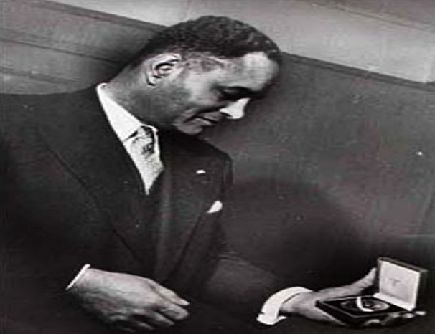
Relationships between Public Sociology and Public Engagement amid Challenges
Enhancing options for public sociology and public engagement in domestic and international venues
Ralph Bunche: “We can never have too much preparation and training. We must adhere staunchly to the basic principle
that anything less than full equality is not enough. If we compromise on that principle our soul is dead.”
“May there be freedom, equality and brotherhood among all men. May there be morality in the relations among nations” (Bunche, 1950).
DECEMBER 10,1950 (DR. BUNCHE VIEWING HIS NOBEL PEACE PRIZE MEDAL).

Slide 17
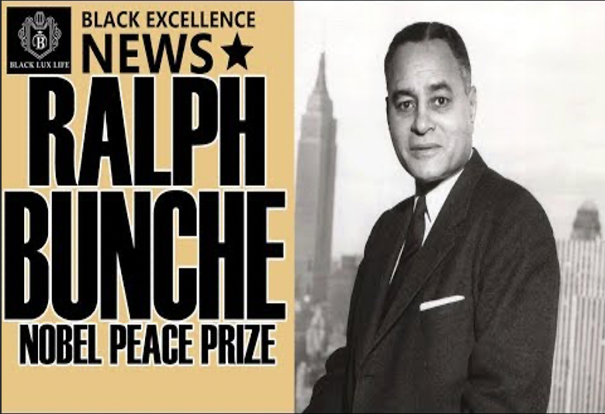
Relationships between Public Sociology and Public Engagement amid Challenges
Nobel Peace Laureate Ralph Johnson Bunche blended social sciences and public engagement for peace, reconciliation, and civil rights.

Slide 18
References*
Arnson, Emily (2021, December 13). Senior Julia Chaffers awarded Marshall Scholarship for graduate study in the UK. Princeton, New Jersey: Princeton University, Office of Communications [https://www.princeton.edu/news/2021/12/13/senior-julia-chaffers-awarded-marshall-scholarship-graduate-study-uk] Retrieved June 24, 2023
Black Excellence News (ND) “Ralph Bunche Nobel Peace Prize.” [https://www.youtube.com/watch?v=K6QWMzTu4aY] Retrieved June 28, 2023
Bunche, Ralph (December 10, 1950). ‘Ralph Bunche Acceptance Speech’ Oslo, Norway: Nobel Prize Foundation [https://www.nobelprize.org/prizes/peace/1950/bunche/acceptance-speech/] Retrieved June 28, 2023
Burawoy, Michael(2021). Public Sociology. Cambridge, UK: Polity Press
Bureau of Educational and Cultural Affairs (November 1, 2022). “Fulbright: Diversity, Equity, Inclusion, and Access,” Washington, DC: Bureau of Educational and Cultural Affairs. [eca.state.gov/Fulbright] Retrieved June 25, 2023.
Centers for Disease Control and Prevention (April 3, 2023). “Working Together to Reduce Black Maternal Mortality,” Atlanta, GA: Centers for Disease Control and Prevention.
[https://www.cdc.gov/healthequity/features/maternal-mortality/] Retrieved June 24, 2023.

Slide 19
References (cont.)
Centers for Disease Control and Prevention (June 2023). “The USPHS Syphilis Study at Tuskegee,” Atlanta, GA: CDC [https://www.cdc.gov/tuskegee/index.html] Retrieved July 15, 2023
Cramer, Maria (October 15, 2021). “Henrietta Lacks, Whose Cells Were Taken without Her Consent, Is Honored by W.H.O.,” New York: New York Times [https://www.nytimes.com/2021/10/13/science/henrietta-lacks-cells-who.html] Retrieved July 15, 2023.
Fulbright Association (April 2023), “Fulbright Prize for International Understanding,” Washington, DC: Fulbright Association. [https://fulbright.org/programs/prize/] Retrieved April 20, 2023.
Kao, Kathryn (2021) “Adventurous Rhodes in Education: Phaidra Buchanan breaks new ground as UGA’s first African American Education Rhodes Scholar.” Athens, Georgia: Mary Frances Early College of Education Alumni Magazine. [https://explore.coe.uga.edu/adventurous-rhodes-in-education/index.html] Retrieved June 24, 2023

Slide 20
References (cont)
Korgen, Kathleen & White, Jonathan. (2023) The Engaged Sociologist. Los Angeles, CA: Sage.
Lindsay, Beverly. (Spring, 2023). “Diplomacy, Technology, and Intellectual Migration: Indispensable Nexus for Fostering Global Equity.” Pittsburgh, PA: Comparative and International Education Society. [https://cies2023.org/written-responses/diplomacy-technology-and-virtual-intellectual-migration-indispensable-nexus-for-fostering-global-equity/] Retrieved April 29, 2023
Lindsay, Beverly et al.(2022). Higher Education Policy in Developing and Western Nations. London and Routledge: Routledge.
Lindsay, Beverly (Senior Author and Editor) (2021). Comparative and International Education: Leading Perspectives from the Field. New York & London: Palgrave Macmillan
Lindsay, Beverly (Senior Author and Editor) (2008). Ralph Johnson Bunche. Urbana, IL: University of Illinois Press.
Lynch, Jamiel & Reiss, Rebekah (June 14, 2023). “Olympic Medalist Torie Bowie Died from Childbirth Complications, Autopsy Finds,” Atlanta, GA: CNN [https://www.cnn.com/2023/06/13/sport/tori-bowie-sprinter-childbirth-death-spt/index.html] Retrieved July 15, 2023.

Slide 21
References (cont)
Marshall Scholarships & Mukharji, Aroop (2023). “A Brief History of the Marshall Scholarships,” London: Marshall Scholarships [https://www.marshallscholarship.org/about/our-history] Retrieved July 15, 2023.
Martin, Roland S. [Roland S. Martin]. (2023, March 4). DEI Jobs Was BULLSH*T: Diversity, Equity & Inclusion Jobs VANISH In Corporate Layoffs [Video]. YouTube. https://m.youtube.com/watch?v=TJrkisZ2CA4
Merton, Robert K. (1972). “Insiders and Outsiders: A Chapter in the Sociology of Knowledge,” American Journal of Sociology 78(1)
Mills, C. Wright (1959). The Sociological Imagination. Oxford, England: Oxford
Nietzel, Michael (November 22, 2020) 2021 Rhodes Scholars Have Been Selected: The 32 U.S. Winners Are Among The Most Diverse Ever
Forbes [www.forbes.com/sites/michaeltnietzel/2020/11/22/the-2021-rhodes-scholars-have-been-selected-th] Retrieved June 24, 2023
Ruf, Jessica (November 20, 2021) “2022 American Rhodes Class Features Six Black Students and Most Women Ever Selected.” Smithtown, New York: Diverse: Issues in Higher Education
[https://www.diverseeducation.com/news-roundup/article/15281943/2022-american-rhodes-class-feature-six-black-students-and-most-women-] Retrieved June 24, 2023.

Slide 22
References (cont)
Santhanam, Laura (December 14, 2021). “Nurse who got first authorized U.S. Covid vaccine”, Arlington, VA: PBS News Hour
[http://pbs.org/newshour/health/Sandra-Lindsay-nurse-who-got-historic-covid-vaccine-reflects] Retrieved June 24, 2023.
Tamdgidi, Mohammad H. (2008). Private Troubles and Public Issues
[https://doi.org/10.1002/9781405165518.wbeos1673] Retrieved June 17, 2020
Tamdgidi, Mohammad H. (2008) Public sociology and the sociological imagination: revisiting Burawoy's sociology types. Humanity & Society, 32 (2), 131– 143 [https://onlinelibrary.wiley.com/doi/abs/10.1002/9781405165518.wbeos1673] Retrieved June 18 2023.
U.S. Department of State (May 20, 2021).“20 Fulbright HBCU Institutional Leaders: Week of Activities with HBCUs,” Washington, DC: Bureau of Educational and Cultural Affairs [https://eca.state.gov/highlight/us-department-states-bureau-educational-and-cultural-affairs-announces-20-fulbright-hbcu] Retrieved April 29, 2023
* Formats for the references vary somewhat. Various citations were copied directly from web citations, i.e., with multiple formats.

