Slide 1
Autobiographical and Biographical Reflections and Policies Regarding Tenure,
Professorships, and Executives in Domestic and International Universities
by
Beverly Lindsay*
Co-Director and Principal Investigator – University of California
and
Fellow, World Academy of Art and Science
Fellow, American Association for Advancement of Science
Association of Black Sociologists 2024 Conference
August 2024
Montreal and Quebec Province sites
*This presentation represents the perspectives and views of the author, not those of funding agencies. The Ford Foundation, Fulbright Program, and National Science Foundation funded fellowships and grants for the author’s background material and research. Appropriate protocols were adhered.

Slide 2
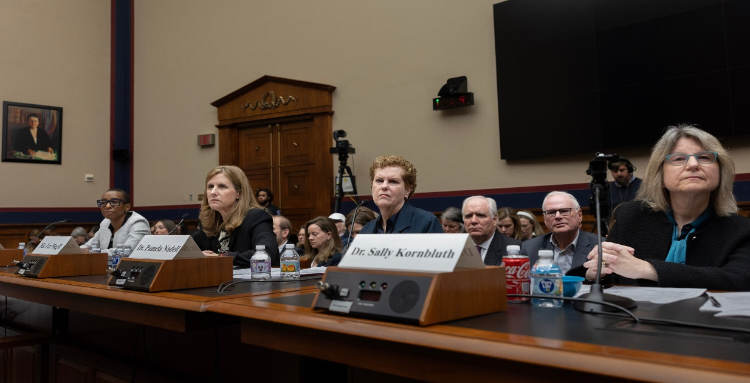
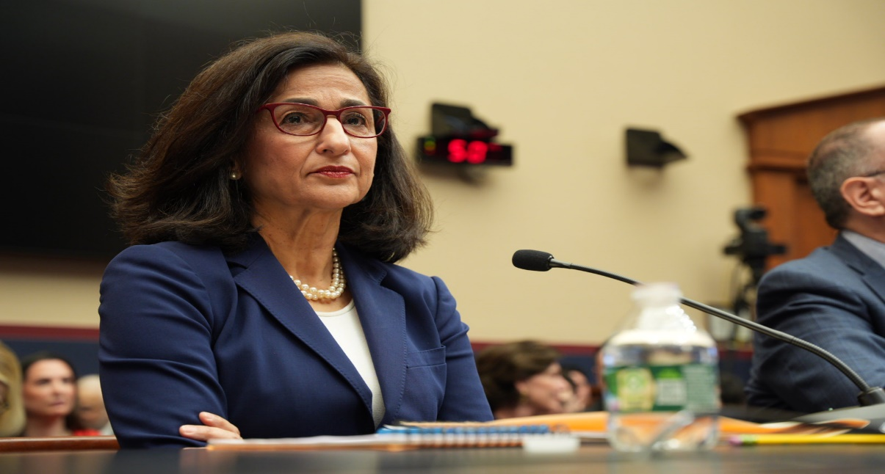
“Create a learning environment in which we respect
each other’s dignity and treat one another with
compassion, and to affirm our enduring commitment
to open inquiry and free expression in the pursuit of truth.”
(Gay, 2024)
Harvard University President Claudine Gay and Columbia University President Minouche Shafik testify before Congress in 2023-2024 academic year (far left side photo of Dr Gay and right side photo of Dr. Shafik)

Slide 3
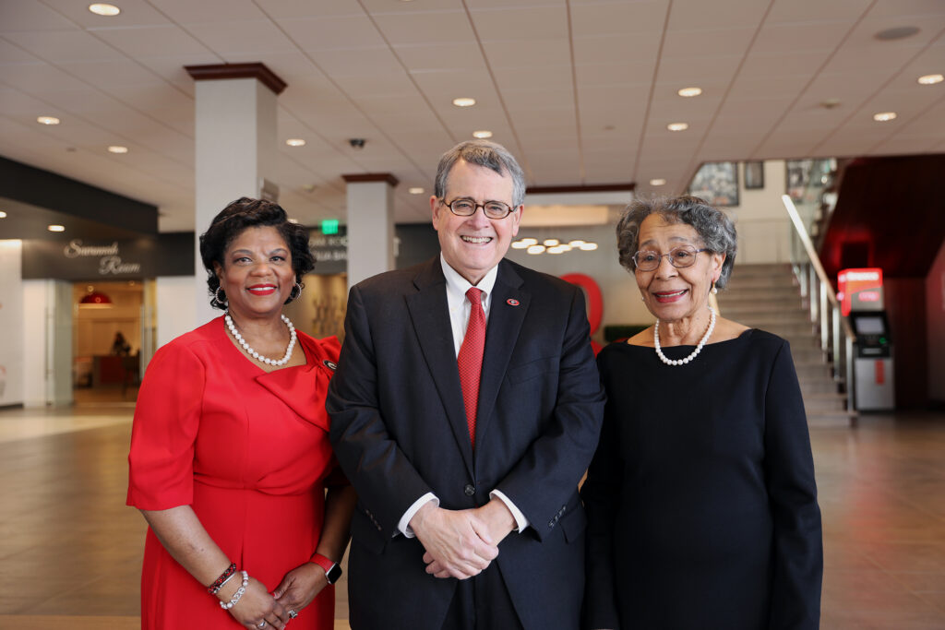
Overarching Objectives
Relationship primarily of de facto and de jure policies to:
Tier One Research universities
Select private colleges
Internal and external factors affecting universities
Tenure and promotion to professorships and to executive positions (deans, vice presidents, presidents/chancellors)
Mary Frances Early (far right) – First African American to earn a degree (in 1962) from the University of Georgia – Trail Blazer for African Americans with College of Education renamed Mary Frances Early College of Education

Slide 4
Salient Context for Presentation
1. American and British university statistical data
Profiles of demographic characteristics
Percentages of women, African Americans, and
Black British (English)
University of California system
California State University system
Russell Group Universities in Britain
2. Illustrations of Autobiographical and Biographical African American/Black women via qualitative case studies and narratives
From Tuskegee – Historically Black College and University (HBCU) to Vice President at American Tier One Research University to consulting with the White House to President of regional state university and Black Ivy
From a Catholic University to USA Department of State – with diplomatic assignments in other nations – to an HBCU to American Tier One Research Universities sites and British Russell Group
3. Illustrations of Black women Presidents of Harvard and Columbia Universities

Slide 5
Critical Social Science Conceptual Frameworks
Front Stage and Back Stage (Goffman, 1959) and
Averted Gaze (Wisniewski, 2000)
Tier One Research universities
Tier Two/Three Comprehensive universities
Private Colleges or Universities
Domestic and International League or Ranking Tables
2. Impact and Interactive effects of social sciences and legal structures
Individual and collective impacts of demographic and geopolitical variable realities, i.e., local, city or state, and national or international (Andersen, et al; 2024; Bell, 1993; Lindsay, et al; 2023; Myrdal, 1944)

Slide 6
Critical Social Science Conceptual Frameworks (continued)
Current and emerging public and private university policies
Macro policies
Meso policies
Micro policies
Blended scaffolds of de facto and de jure policies
5. Synthesis of frameworks and qualitative articulations vis á vis Black women

Slide 7
American University Statistical Data
California universities are located in the most populous state with 39,000,000 residents. The state would be among the world’s top ten in gross domestic products (GDP) if an independent nation (World Bank, 2022).
Top Tier public university system
University of California system with 295,573 students (University of California, 2024) [1]
Berkeley 1500 faculty
Ladder Faculty, about 84% are tenured
Percentage of tenured Black faculty Berkeley cohort, i.e., women 35% of Blacks (65% males)
Student enrollment 33,078 (Fall 2023)

Slide 8
American University Statistical Data (continued)
Tier two or three research tier and teaching public university system
California State University system with 457,992 students (California State University System, 2023a) and 13,601 full time faculty and 55.7 % are tenured associate and full professors (California State University, 2023a; California State University, 2023b [2]
Percentage of all associate and full professors tenured women – 44%
Percentage of Black and/or Latina women (those specific demographics)
Percentage of instructional faculty – Black women 57% (includes non- permanent budget positions) – many are not designated as tenurable
Percentage of instructional faculty – Latina women 54% -- many are non-permanent budget positions

Slide 9
British University Statistical Data
Population of England and Wales 59,597,300 (56,489,800 in England and 3,107,500 in Wales (United Kingdom Government, 2021)
Russell Group [3]
Russell Universities composed of 24 leading public British universities, e.g., Oxford, Cambridge, University College London, and Cardiff [3]
Roughly equivalent to public Tier One research universities, e.g., all University of California sites, except one. and most major American land-grant universities
Equity, Diversity, and Inclusion – policies in Russell Group, i.e., different order of components, compared to the United States – Diversity, Equity and Inclusion

Slide 10
British University Statistical Data (continued)
University College London largest university with nearly 37,000 students (Russell Group, University College London, 2024)
Institute of Education of UCL – over 100 academic teaching and/or research faculty (roughly American nomenclature) – one Black woman associate professor and three full professors – two women and one man in early 2024
Lindsay, PhD, EdD – Visiting Professor – via review process becoming an actual “full” Visiting Professor

Slide 11
British University Statistical Data (continued)
University of Oxford with approximately 22,600 students and constantly (ranked as number 1) in the world via Times Higher Education, Quacquarelli Symonds (QS) World University Ranking (aforementioned located in London) and US News and World Report in top 5 (University of Oxford, 2024); QS, 2024; US News and World Report, 2023)
Oxford has over 30 colleges, i.e., somewhat different structure than universities in USA (University of Oxford, 2024)

Slide 12
British University Statistical Data (continued)
Green Templeton College, University of Oxford – strictly a graduate college with approximately 700 students (Green Templeton, 2023)
Lindsay – Visiting Professor per designation by late Principal David Watson of GTC
Lindsay did not meet any Black academic tenured faculty
Black and Minority Ethnic (BAME) as self-identified 5% (Green Templeton, 2019)

Slide 13
Conceptual Frameworks
Front Stage and Back Stage (Goffman, 1959)
Theater performance where actors are visible to audience, i.e., front stage (on stage) following script and director
Official Criteria – Front Stage
Election by Harvard Corporation of woman president and Columbia Board of Trustees woman president – Both Black women/women of color
Selection from within and/or perceived “Peer” universities and/or top Federal and/or national agencies, e.g., World Bank, and American or British Commissions of Executive Offices

Slide 14
Conceptual Frameworks (continued)
Theater performance where actors are back stage (off stage) invisible to audience
Varied behaviors: tell jokes, leave theater, ridicule others, discuss theater and public politics, etc.
Black woman and stereotypes and whispers of plagiarism and absence of highest academic behavior and research
Geopolitical ramifications of African American and British – Egyptian- American woman
Columbia president requested assistance from New York city police during extensive student demonstrations over post-October 7, 2023 atrocities in Gaza, Israel, and West Bank
Knowledge of political dynamics of women presidents of Harvard, MIT, and University of Pennsylvania testimonies before congress
Sociopolitical dimensions affecting public and private universities. e.g., state legislatures and city councils, alumni, and donors

Slide 15
Conceptual Frameworks (continued)
Averted Gaze (Wisniewski, 2000)
Overlook and/or divert attention away from salient issues
Espouse necessity of multiple demographic challenges and at other sites
Decline to acknowledge various realities of demographic conditions at home sites
Camouflage adversities at local university, while decrying elsewhere
Hiring and promotion of faculty of color; yet staff of color hires are often placed/hired in non-tenured or associate professor or staff with no line budget and/or authority
Comparisons with inappropriate criteria e.g., regional Tier Two universities with Tier One
Political dimensions internal and external to university

Slide 16
Conceptual Frameworks (continued)
Impact and interactive effects of social science and legal structures
Perceptions and/or legal constructs of demographic groups, e.g., ethnicity/race, constant and emerging genders, able-bodied and non-able-bodied, height and weight, city or state (Andersen, 2022; Andersen & Baca Zinn, 2024; Bell, 1993; Kraft & Furlong, 2020; Lindsay, et al, 1983)
Predecessors and impacts of aforementioned perceptions and constructs
Types of universities where BA/BS/BBA earned and/or PhD/EdD/DSW/JD degrees awarded, e.g., Tier One or Tier Two research universities, Little Ivys or Black Ivys

Slide 17
Conceptual Frameworks (continued)
Impact and interactive effects of social science and legal structures of universities
Designations of admissions criteria, doctoral assistantships and fellowships, and funding bodies, e.g., Rhodes, Fulbright, National Science Foundation, Ford Foundation, etc.
USA Supreme Court (June 2023)

Slide 18
Conceptual Frameworks (continued)
National and International Policies
Policies as fundamental principles that establish the overall directions for public agencies, universities, and organizations – includes perceptions of issues to be addressed (Kraft, and Furlong, 2024; Lindsay & Blanchett, 2011; Mitra, 2018; Orfield & Hillman, 2018; Siddiki, 2020; Tandberg et al., 2018) often arise from cultural norms and sociopolitical conditions
Macro-level policies comprehensive overarching principles at play that effect entire entity or organization
Meso- level policies operational in university programs writ large
Micro-level policies at department or institute level by fulltime faculty and professional staff

Slide 19
Conceptual Frameworks (continued)
National and International Policies
Levels of autonomy and decision-making at public and private universities
Harvard, University of California, and California State University decision making
Harvard autonomy and alumni (Ranked number 1 to 5 by League Tables)
University of California autonomy and state funding (Ranked from 3 to 70s, depending upon campus)
California State University autonomy via state and unions (most not ranked in top 100)

Slide 20
Blending Interactive Scaffolding Among de jure policies for hiring & promotions juxtaposed with de facto ones and averted gazes
Dr. Hughes – PhD in counseling and school psychology from public Tier One Research/Very High Research Activity – Florida State University and hired at a two-year college – Obtained appropriate certifications in psychology in accord with de jure policies
De jure and de facto policies permit higher percentage of African American professionals in community colleges

Slide 21
Blending Interactive Scaffolding Among Policies (continued)
Dr. Hughes – Tenured faculty and Associate Vice President for Students Affairs at public Tier Two Research university:
Minority Serving Institute (MSI) with disparate challenges from diverse groups and from dominant race/ethnic group, overt and covert, i.e., front stage and back stage; b) desert climate conditions affect on campus life regarding both de jure and de facto macro and meso policies affecting Dr. Hughes- Vice President for Student Affairs, Vice Provost for Academic Affairs and full professor at major public Tier One university:

Slide 22
Blending Interactive Scaffoldings Among Policies (continued)
Dr. Hughes
c) responsible for student affairs at multiple campuses of university – various interpretations of student affairs among campuses, i.e., front stage and back stage communications and criteria; d) presence of key European American male president, and spouse who provide White male insight into front stage and back stage realities; e) university president encouraged her to become a university president, but ironically at state or regional universities – not at major public Tier One research universities, i.e., front stage and back stage and realities of de facto polices; f) Black woman unlikely to become president at major public research universities, despite internal and external accomplishments

Slide 23
Blending Interactive Scaffoldings Among Policies (continued)
Dr. Hughes first woman President at Black Ivy in large metropolitan areas: a) dealt with one of America’s largest natural disasters where basically all the conceptual frameworks of this presentation were at play; b) front stage and back stage input from governor and meteorologists at initial time of disaster and subsequently with both state and congressional legislators, federal, philanthropic agencies; c) averted gazes of how natural disasters mitigations are not addressed satisfactorily; d) honorary doctorates from Ivy League University and Tier One public research university; e) de jure policies for hiring & promotions juxtaposed with de facto ones post-disasters, in view of averted gazes at other local metropolitan universities

Slide 24
Blending Interactive Scaffoldings Among Policies (continued)
Dr. Lindsay EdD in International and Higher Education Policy program [ranked nationally among top 5] from University of Massachusetts, Amherst, a public Tier One Research site with dissertation and post-doctoral research via Ford Foundation fellowships in Kenya And PhD in Administration and Management in International Affairs foci from The American University, Washington, DC [private university constantly ranked in American top 10 for international affairs] while working in USA Department of State

Slide 25
Blending Interactive Scaffoldings Among Policies (continued)
Dr. Lindsay began academic career as Assistant Professor at Penn State University-University Park (immediately after EdD/first doctorate via recommendation of dissertation advisor): a) taught graduate courses, co-chaired doctoral dissertation committees, and engaged in sociology of education and international research per de jure policy criteria; b) presented refereed papers at national and international conferences on domestic and international post-secondary education; c) encouraged by program head to submit dossier for early tenure and promotion to associate professor; d) discouraged by senior professor in international matters from promotion, since he was not promoted in five years, i.e., back stage action

Slide 26
Blending Interactive Scaffoldings Among Policies (continued)
Dr. Lindsay awarded an American Council on Education Government Fellow at the US Department of Education to: a) plan and implement a national higher education desegregation research program; b) stalled program funding; c) observed back stage realities among favored and lesser favored programs; d) assigned to National Commission on Excellence in Education (created by US Secretary of Education) that produced seminal publication A Nation at Risk; e) de jure and de facto political fights by Congress and White House on roles of education for domestic and international matters during President Reagan’s administration

Slide 27
Blending Interactive Scaffoldings Among Policies (continued)
Dr. Lindsay was highly recommended by an American Presidential appointee to head a public diplomacy higher education programs in English, French, and Portuguese African nations: a) obtained top level security clearance via de jure policies; b) designed and administered multi-million dollar educational and cultural program; c) reported to Career Minister (equal to three-star/lieutenant general); d) observed both positive front stage design and evaluation and back stage criticism from those not involved in comparable programs and line of diplomacy

Slide 28
Blending Interactive Scaffoldings Among Policies (continued)
Dr. Lindsay accepted position as Associate Dean for Academic Affairs and Associate Professor at University of Georgia: a) different budgetary placement of Institute of Higher Education and Academic affairs and College dean did not permit appointment in Institute, i.e., de jure and de facto policies at odds; b) de jure public announcement to hire a full professor; c) some faculty argued that Lindsay PhD just completed and thus ignored EdD earned 12 years earlier, i.e., front stage and back stage; d) secured tenured letter and assurance from dean for promotion and tenure in two year, i.e. de facto insurance in view of de jure policy of Georgia state legislature that no faculty can be granted immediate tenure- must wait at least two years, including University president; e) promoted to full professor and became first Black woman professor in entire history of University of Georgia

Slide 29
Blending Interactive Scaffoldings Among Policies (continued)
Dr. Lindsay appointed university executive director of strategic planning and then dean of international education and policy studies with rank of professor at Hampton University to: a) spearheaded university-wide strategic plan; b) fostered Capital Campaign that began via university provost’s introduction of Dr. Lindsay to university president; c) garnered cooperatively $250 million, i.e., front stage policies; d) established internships with British Parliament, i.e., de facto and de jure policies for HBCU; e) initiated student internships in USA and other countries; and f) obtained USA Agency for International Development grant sub-contract

Slide 30
Blending Interactive Scaffoldings Among Policies (continued)
Dr Lindsay appointed Dean of University International Programs and professor at Penn State: a) coordinated and expanded university endeavors, e.g., garnered $10 million funds/grants/donations and student internships at 2000 Sydney Olympics; b) inclusion in Council of Academic Deans, i.e. but back stage and de facto policies exclusion from council under premise that no academic courses offerings, although international curriculum increased; c) Lindsay opposed Penn State students’ study in Israel during second Intifada due to safety; d) president eliminated deanship after 9-11, 2001 reportedly due to budget reorganizations and evaluation after Lindsay raised issues, e.g., treatment of University Muslim students; e) president later convicted for his role in child sexual abuse case by an assistant football coach – president sentenced to prison and house arrest in July 2021 (after appeals denied)

Slide 31
Blending Interactive Scaffoldings Among Policies (continued)
Dr. Lindsay assumed fulltime professorship in Higher Education and International Studies at Penn State to: a) teach, research, and public service in graduate programs, e.g., awarded Fulbrights in five Asian and African countries and two NSF grants i.e., de jure criteria ; b) voice concerns affecting Black faculty, e.g., dean’s refusal to appoint Black full professors to tenure and promotion committee and appointed a Black woman associate professor, i.e., front stage de jure policy, but back stage in stifling Blacks’ promotions; c) associate dean and dean consistent non-inclusion of Blacks as PIs or Co-PIs

Slide 32
Blending Interactive Scaffoldings Among Policies (continued)
d) associate dean and dean refusal to include HBCU senior professor (who had been PI or Co-PI with $12 million grants) and ended subsequent National Science Foundation (NSF) grant early despite Federal government stating no de jure policy violations, i.e., back stage and de facto rationales; e) myth of Blacks needing to be twice as good to be considered equal to European Americans, i.e., back stage professional jealousy and racism, thus sent assistant and associate professors women of color without notable international expertise to explore overseas initiatives, instead of Black full professors

Slide 33
Blending Interactive Scaffoldings Among Policies (continued)
f) voiced claimed of jealousy to bi-racial Black/White PhD research assistant of jealousy since he was assigned to a domestic and international National Science Foundation grant – similar statements to Black PI, i.e., front stage and de facto policies; g) Black professor criticized for requiring graduate students to read higher education speeches by President Obama, but not those of former Presidents Bill Clinton and George W. Bush, h) absence of Black women full professors with named or endowed chairs in 2022 throughout the university, i.e., back stage de facto policies

Slide 34
Synthesis of Frameworks and Qualitative Articulations
vis á vis Black Women Presidents and Professors
Understanding descriptive statistics vis á vis conceptual frameworks from multiple disciplines
Integrating conceptual frameworks, particularly those of front stage, back stage and, averted gaze realities, in various environments – especially those beyond single endeavors, e.g., Harvard and Columbia University presidents’ interactions with internal and external audiences

Slide 35
Synthesis of Frameworks and Qualitative Articulations
vis á vis Black Women Presidents and Professors (continued)
Recognizing that averted gazes enable both positive and challenging onsite matters to enhance conditions or elude equitable solutions
Anticipating opportunities and adversities throughout professional communications in political and non-work situations
Acknowledging that many conditions are beyond individual’s and/or groups’ ability to address at the time, thus plan alternatives and contingencies in light of realistic goals and landscapes – resilience with authentic goals

Slide 36
“I trust we will all find ways, in this time of intense challenge and controversy, to recommit ourselves to the
excellence, the openness, and the independence
that are crucial to what our university stands for – and our capacity to serve the world.”
(Gay, 2024)
“We believe that Columbia’s role is not to shield
individuals from positions that they find
unwelcome, but instead to create an
environment where different viewpoints can
be tested and challenged.”
Shafik (2024)

Slide 37
Both quotes were presented by the Harvard University President and Columbia University President (respectively) during similar periods when they testified before Congress. The Harvard president soon resigned, while the Columbia president initially retained her presidency. Months later the Columbia president resigned and returned to England and became positioned in the newly elected Labor Party Foreign Secretary/Minister of Foreign Affairs. Domestic and geopolitical concerns may both have been at play, thereby illustrating how contexts change within weeks – or even years later. [4]
Mary Frances Early was physically threatened, ridiculed (and even queried if she had been a “lady of the evening/night”) and ostracized before and after she entered the University of Georgia. Half a century later, the College of Education was renamed the Mary Frances Early College of Education – in view of her extraordinary reliance and contributions throughout Georgia and elsewhere.

Slide 38
End Notes
[1] The central Presidential Office of the University of California system provides university-wide demographic faculty and budgetary information, but not indepth data on specific campuses. Instead, researchers are directed to offices at the several University of California sites, where consistent comparable information is not always evident.
[2] The central Chancellor Office of the California State University provides system-wide demographic and faculty budgetary information, in more detailed data than the University of California Presidential Office. Hence, there is a difference between the two systems in available data.
[3] The British Higher Education Statistics Agency (HESA) central office has collected data from higher education institutions throughout the United Kingdom. However, there are not extensive open-source free data, comparable to the American Department of Education – National Center for Education Statistics (NCES). It is somewhat analogous to the collection manner of the University of California system office.
[4] The men Presidents of Northwestern University and Rutgers University and Chancellor of the University of California, Los Angeles (UCLA) also testified before Congress. The Northwestern and Rutgers presidents did not resign shortly after their Congressional testimonies. The Chancellor of UCLA resigned in summer 2024; however, he had been in office for over 15 years and had previously announced retirement plans during summer 2023. These men likely learned from observing the previous testimonies by Harvard and Columbia women presidents. Nevertheless, gender roles may have been de facto criteria for their remaining in office.

Slide 39
Initial Select References
Advance HE (2023) Equality+ Higher Education England
[https://www.advance-he.ac.uk/search?q=Definition%20of%20SET] Retrieved July 20, 2024.
Andersen, Margaret & Bacca Zinn, Maxine. (2024). Moving from the Margins: Life Histories on Transforming the History of Racism: Palo Alto, CA: Stanford University Press.
Andersen, Margaret. (2022) Race in Society: The Enduring American Dilemma. Lanham, Md: Rowman & Littlefield.
Bell, Derrick (1993). Faces at the Bottom of the Well: The Permanence of Racism. New York: Basic Books.
Buchwald, Elisabeth Shafik (2024), “ Opening remarks highlight Columbia’s struggle,” New York: CNN Quoting Minouche Shafik
California State University System (2023). “Enrollment” Long Beach, CA. [https://www.calstate.edu/csu-system/about-the-csu/facts-about-the-csu/enrollment] Retrieved February 1, 2024.

Slide 40
California State University (2023 a). “CSU Work Force,” Long Beach, CA: California State University [https://www.calstate.edu/csu-system/faculty-staff/employee-profile/csu-workforce] Retrieved July 30, 2024
California State University (2023 b) “CSU Work Force “The Employees of the California State University,” Long Beach, CA California State University [[https://www.calstate.edu/csu-system/faculty-staff/employee-profile/Documents/Fall2021CSUProfiles.pdf] Retrieved July 30, 2024
Gay, Claudine (January 2, 2024). “Personal News” Cambridge, MA: Office of the President:
[https://www.harvard.edu/president/news-gay/2024/personal-news/] Retrieved July 10, 2024
Green Templeton (2019). “Diversity Data.” Oxford, England: Green Templeton College [ttps://www.gtc.ox.ac.uk/wp-content/uploads/2019/03/GT-Staff-Diversity-Data-11.3.19-for-website.pdf?_gl=1*8qwknq*_up*MQ..*_ga*OTAxNjAxODcyLjE3MjIzNDg3MDA.*_ga_1VFN1VJQDG*MTcyMjM0O] Retrieved July 30, 2024

Slide 41
Green Templeton (2023). “Student Profiles,” Oxford, England: Green Templeton College, [https://www.gtc.ox.ac.uk/students/student-profiles/?_gl=1*zqydh8*_up*MQ..*_ga*MTA5OTMwMzAzNC4xNzIyMzQ5NDMx*_ga_1VFN1VJQDG*MTcyMjM0OTQzMC4xLjAuMTcyMjM0OTQzMC4wLjAuMA..] Retrieved June 30, 2024
Goffman, Erving (1959). The Presentation of Self in Everyday Life. New York, NY: Doubleday.
Kraft, Scott R. & Furlong, Michael (2024). Public Policy: Politics, Analysis, and Alternatives. Washington, DC: CQ Press.
Lindsay, Beverly (2022). Higher Education Policy in Developing and Westerns Nations:
Comparative and Emerging Trends in Local and Global Contexts. London and New York: Routledge.
Lindsay, Beverly (Senior Author and Editor) (2021). Comparative and International
Education: Leading Perspectives from the Field. New York & London: Palgrave Macmillan.
Lindsay, Beverly & Blanchett, Wanda J. (Senior Authors and Editors) (2011). Universities and Global Diversity: Preparing Educators for Tomorrow. New York & London: Routledge.
Lindsay, Beverly (2006). International dimensions of prevention. In Carl Grant & Liane M. Summerfield (Eds.), Humanizing Pedagogy: Through HIV and AIDS prevention, 203-205. Boulder, CO: Paradigm.

Slide 42
Lindsay, Beverly (1987). Developing and evaluating an educational program designed for public diplomacy: The teacher-text-technology program. Journal of Negro Education, 56(3), 390-406.
Lindsay, Beverly (senior author and editor). (1983). Comparative Perspectives of Third World Women: The Impact of Race, Sex, and Class. Westport, CT: Praeger.
Myrdal, Gunnar (1944) . An American Dilemma: The Negro Problem and Modern Democracy. New York: Harper and Brothers
Russel Group (2024). University College London. Cambridge: UK [https://russellgroup.ac.uk/about/our-universities/university-college-london/] Retrieved July 1, 2024
Russel Group (2024). University of Oxford. Cambridge, UK: [https://russellgroup.ac.uk/about/our-universities/university-of-oxford/] Retrieved July 1, 2024
Shefik, Minouche . (April 17, 2024) “Statements from the April 17, 2024 Congressional Hearing Committee,” New York, New York: Columbia News. [https://news.columbia.edu/news/statements-april-17-congressional-committee-hearing] Retrieved July 11, 2024
University of California, Riverside (2023) “UC Riverside Faculty Salary,” Riverside, CA: University of California, Riverside [https://www.univstats.com/salary/university-of-california-riverside/faculty/] Retrieved July 30, 2024

Slide 43
University of California System (January 14, 2024) “Fall Enrollment at a Glance,” Oakland: California: University of California [https://www.universityofcalifornia.edu/about-us/information-center/fall-enrollment-glance] Retrieved January 20, 2024
US Census Bureau (2022) “Quick Facts.” Washington, DC: US Bureau of Census. [https://www.census.gov/quickfacts/fact/table/CA/PST045222] Retrieved February 2, 2024.
United State Supreme Court (June 29, 2923). “Students for Fair Admissions, Inc. v Presidents and Fellow of the Harvard College,” Washington, DC: US Supreme Court. [https://www.supremecourt.gov/opinions/22pdf/20-1199_l6gn.pdf] Retrieved February 20, 2024.
Wisniewski, Richrd (2000). “The averted gaze.” Anthropology and Education. Vol 31 (1) 5-23

